Slide 1

Regione Lombardia eGovernment & eInclusion
daniele.crespi@lispa.it
www.slideshare.net/dcrespi
2011 May, 6

Slide 2

Lombardia Region
Is one of the twenty Italian Regions
About 17% of Italy’s citizens
Is one of the most populated Regions of Europe - about 10 Mln (more populated than 14 EU member States)
Its GDP is about 20% of Italy’s GDP

Slide 3
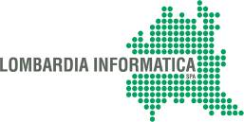
Lombardia Informatica s.p.a.
Responsible for the soundness and the effectiveness of the whole Regional Information System
Responsible for technological innovation
Unique interface between Regional Government and the marketplace
Provider of development and maintenance for Regional Information System
Developer for the CRS-SISS Project
(Regional Healthcare Information System)
Delivery of Call and Contact Center services to all Lombardy Citizens in the e-Government area
( mainly in the health environment )
> 650 people
> 240 Mln €

Slide 4
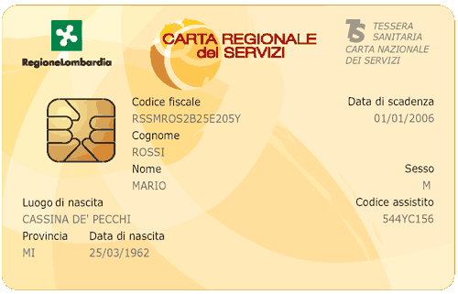
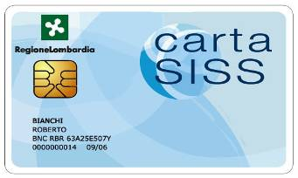
CRS-SISS Project Overview
The Carta Regionale dei Servizi – Sistema Informativo Socio-Sanitario (CRS-SISS; Regional Services Card - Healthcare-Social Information System) is one of the most important Italian e-Healthcare project.
The core of the project is the creation of a network, a ‘Healthcare Extranet’, which links operators, social services, organizations and citizens, tracking all the events which occur in the patient treatment (from prescription to administration) and providing value added services.
The project is based on Smart Card technologies, granting access to the Network to both citizens and operators by their personal smart card.

Slide 5



The Healthcare Network of Lombardia
9.850.000 Citizens
150.000 Health & Social Care Operators
8.500 General Practitioners and Pediatricians
2.500 Pharmacies
15 Local Healthcare Units
34 Public Healthcare Services Suppliers (29 Public Hospital and 5 Public Scientific Services)
Over 2500 Private Healthcare Services Suppliers
REGIONE
REGIONE
LOMBARDIA
LOMBARDIA
PHARMACIES
PHARMACIES
HOSPITALS
HOSPITALS
CITIZENS
CITIZENS
GENERAL
GENERAL
LOCAL HEALTH
PRACTITIONERS
LOCAL HEALTH
PRACTITIONERS
CARE UNITS
CARE UNITS
HEALTH & SOCIAL
HEALTH & SOCIAL
ASSISTANCE
ASSISTANCE

Slide 6
Lombardy’s Region
Healthcare Information System evolution
1978
Collection and filing of hospitalizations
1982
Regional personal data Registry of Citizens and General Practitioners
1985
Collection and filing of pharmaceutical acquisitions
1997
Collection and filing of out patient visits data
CRS-SISS PROJECT
1999
2000 -2001
2002
2004
2005
2008
2009
Project requirements definition and feasibility analysis
On site pilot project in the Lecco District
(300.000 citizens)
Project Financing
and beginning of the expansion to all Districts
2 million
citizens
All Lombardy’s citizens
(9,5 million)
Healthcare
Private Sector
On-line services

Slide 7
CRS-SISS - Services
Citizen Identification: Regional General Registry and Citizen Card
e-Prescriptions Management to enable a truly digital use of prescriptions during their life cycle
Electronic Health Record (EHR): shares clinical data among HC Professionals (events, prescriptions, reports, care profile, …), enables on-line access for Citizens
Booking and Payment Services for Citizens by Internet, GP, Pharmacies, Regional Call Center, to improve citizen’s access to HC services
Business Intelligence and DataWarehouse to make analyses and forecasts of epidemiological trends and to manage and forecast regional healthcare expenditure trends
Digitalisation of all medical and administrative documents in order to improve efficiency and effectiveness of processes
Accounting information flow management: incremental records of administrative data in order to ensure on-line updating of Business Intelligence and Data Warehousing Systems
Electronic signature, mailing system, encryption functionality

Slide 8
Smart Cards Technology -Why
  Identification and authentication
  Storage of information needed for emergency care (Netlink standard)
  Access to Public Administration services
  Certification of the “presence” of the Citizen (through electronic signature of documents)
  Identification and authentication
  Authorization to gain access to the System (according to operator’s profile)
  Digital Signature
Citizen Card
Operator Card

Slide 9
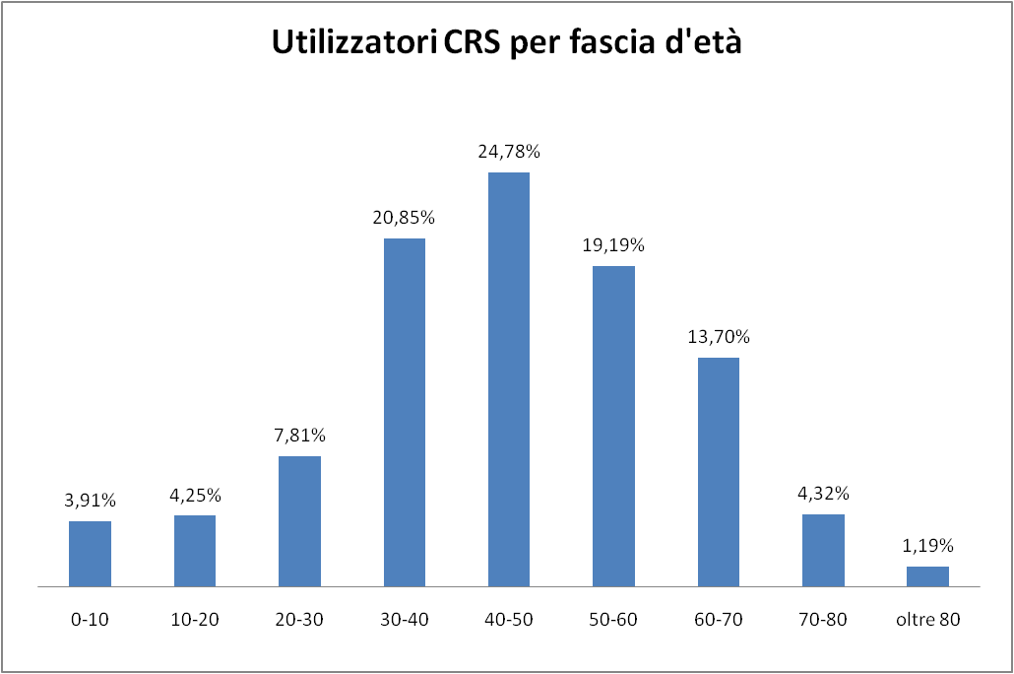
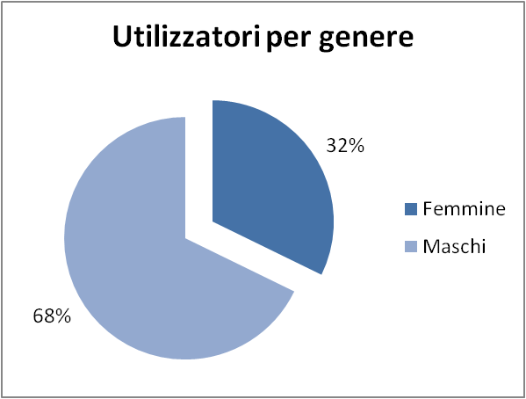
Age & gender
19%
>60 years
65%
31-60 years

Slide 10
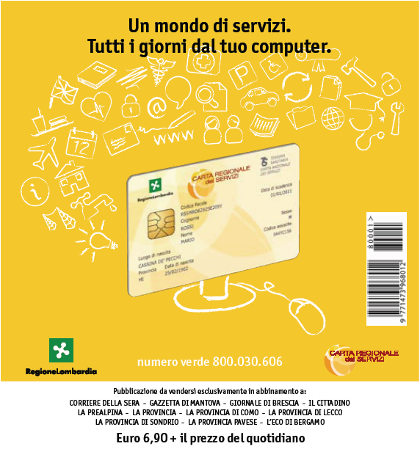
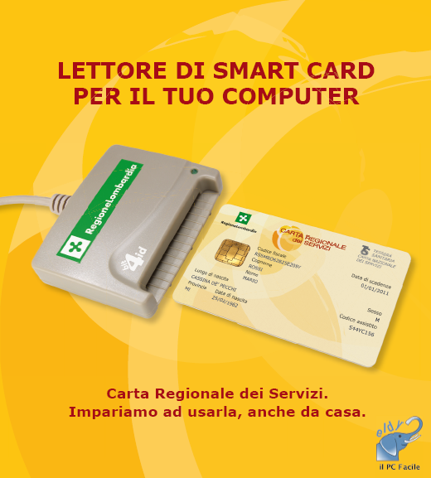
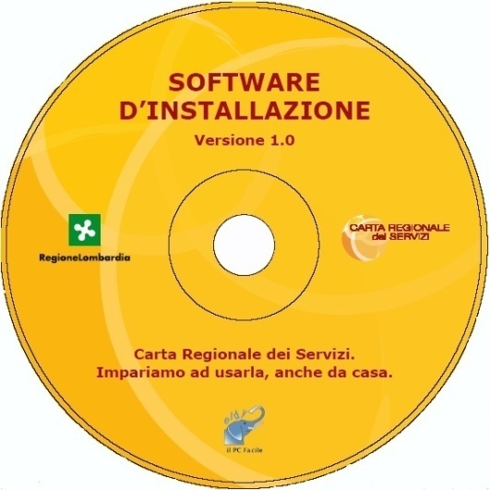
Smart card reader distribution
Bundle with newspapers: 7,5€ - 240.000 smart card reader sold !
Other initiatives in collaboration with municipalities - 200.000 distributed
Booklet
Smart Card Reader
Software:
  eID card software
  Eldy Lombardia

Slide 11


Cultural Digital Divide
Very few aged people use PC & Internet
87% of over 55 have no computer skills
Source: Eurostat Statistics In Focus 17/2006
66% of italian people don’t know english language
Another 8% have very low knowledge

Slide 12
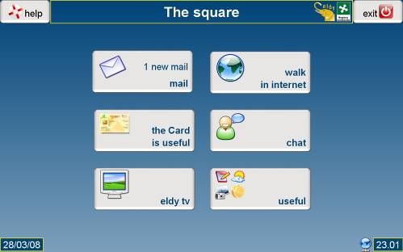

Easy PC & Internet Programs
ELDY (www.eldy.org) :
  NGO (sponsorship Min. Welfare and Min. Communications)
  Eldy : free software, more than 300.000 downloads
  email, browser, chat, notepad, video, image viewer & more
  Realized for the elderly with elderly collaboration

Slide 13
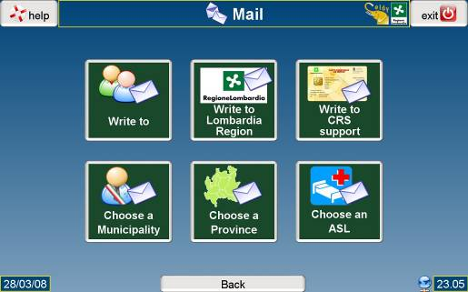
Reachable eGovernment
Eldy Lombardia (special version for lombardia citizens)
  Integrated with our eID smart card (authentication, digital signature)
  email address book of all Lombardia local government
  web site index of all Lombardia local government
  multi-user version for public internet access points

Slide 14
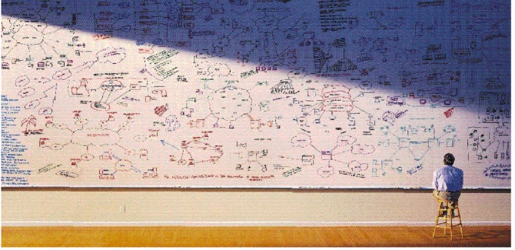
Q & A

